Slide 1
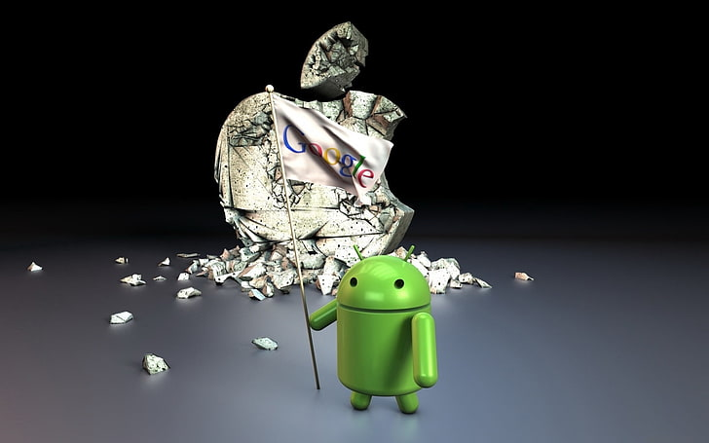
SENTIMENT ANALYSIS TWITTER DATA Android & Iphone
By GROUP ONE
1

Slide 2

Business Understanding
Apple and Google are two of the most influential tech companies globally, with millions of users and customers who actively discuss their products on platforms like Twitter.
However, manually analyzing sentiment in these discussions would be both time-consuming and impractical given the sheer volume of tweets.
Therefore, automating sentiment analysis using an NLP model will allow both companies to process and understand consumer opinions quickly and at scale.
This could give them a competitive edge by allowing for a timely response to customer feedback, identifying emerging issues, and improving customer satisfaction and brand loyalty
2

Slide 3
Project Overview
Social media platforms like Twitter provide a great amount of realtime insights into customer opinions, especially regarding products and services. For tech gaints like Apple and Google, monitoring sentiments around their products can be a crucial business strategy. Understanding how consumers feel about their products or services, whether positively, negatively or neutrally, helps inform marketing strategies, product development and customer support.
This project aims to build a Natural Language Processing (NLP) model to analyse the sentiment of tweets related to Apple and Google Products.
3

Slide 4
OBJECTIVES
Main Objective
To develop an NLP-based machine learning model that can accurately classify the sentiment of tweets related to Apple and Google products as positive, negative, or neutral.
Specific Objectives
Build and evaluate multiple machine learning and deep learning models to classify tweet sentiments.
Preprocess tweet data effectively through removing noise, handling stopwords and tokenization, to improve model accuracy.
Identify patterns in customer sentiments towards Apple and Google products.
4

Slide 5
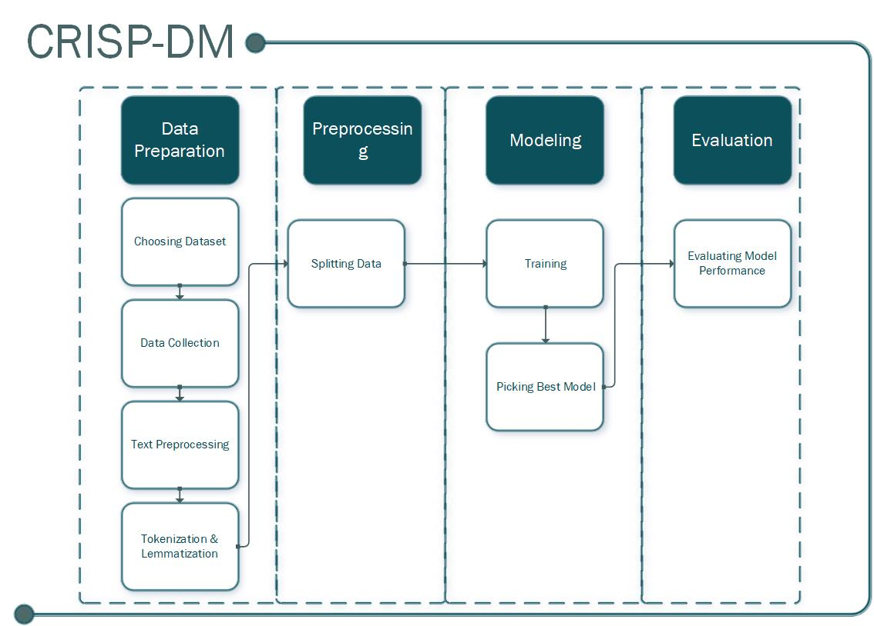
METHODOLOGY

Slide 6
Data Collection
The dataset is from CrowdFolder via data.world. The dataset consists of over 9,000 tweets that have been rated by human annotators as positive, negative or neutral sentiment.
Data Description
Column | Data Type | Description
tweet_text | object | It contains text data.
emotion_in_tweet_is_directed_at | object | It contains categorical or string values indicating emotion direction.
is_there_an_emotion_directed_at_a_brand_or_product | object | It holds categorical values ('Negative emotion', 'Positive emotion’, 'No emotion toward brand or product' and 'I can't tell').
5

Slide 7

LIBRARIES
Data Manipulation | Text Processing | Visualization | Preprocessing | Modeling
Numpy | Natural Language Processing Kit Regex | Matplotlib Seaborn Word Cloud | Label Encoder Tokenizer Vader | Sklearn Tensorflow Keras
6

Slide 8
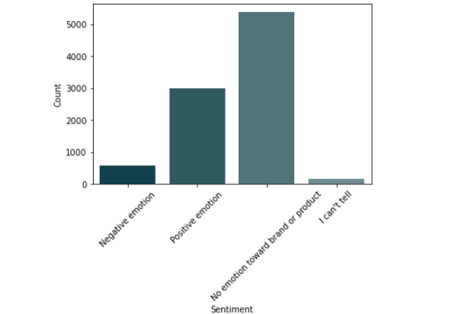
ANALYSIS
Tweet Sentiment Distribution
Most people have no emotion towards a most brands and few people can tell

Slide 9
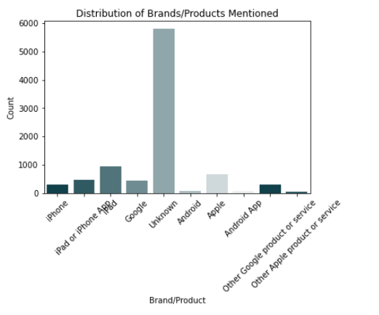
Distribution of Brands/Products Mentioned
Most respondents emotion is directed to unknown barnds and iphone products(iphone and ipad) follow as top 3 brands which emotions are directed at.

Slide 10
Distribution of Brands/Products Mentioned
Most respondents emotion is directed to unknown brands and iphone products(iphone and ipad) follow as top 3 brands which emotions are directed at.

Slide 11
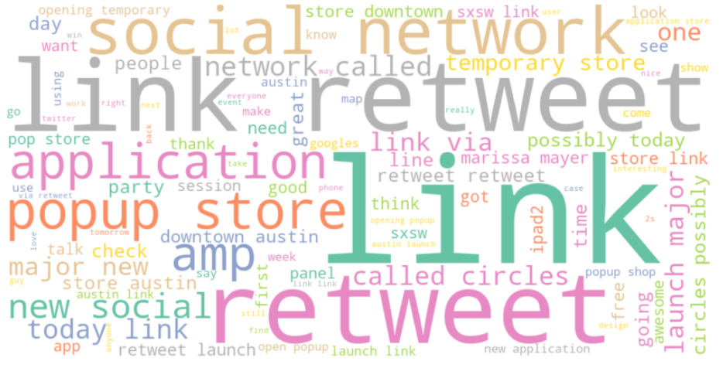
Word Cloud from Tweets
The words in most frequently used words in the tweets is link, retweet

Slide 12
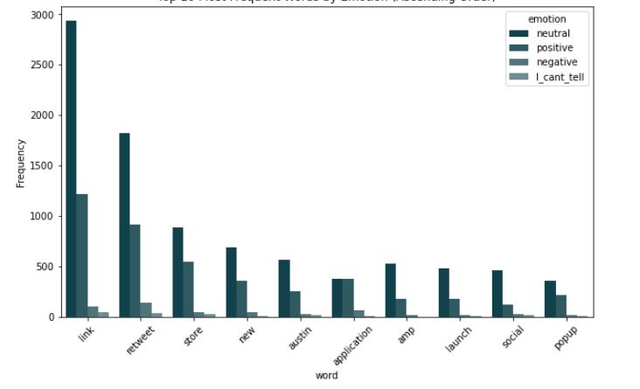
Top 10 Most Frequent Words by Emotion
Most respondents emotion is associated seems to be distributed evenly across the words.

Slide 13
EVALUATION
Models
66%
77%
86%
89%
Random Forest
Logistic
Regression
Multiclass Neural
Network
LSTM
Neural
Network
Random Forest: 84% accuracy, 77% macro F1 — better than Logistic Regression, interpretable, captured complex patterns.
Logistic Regression: 66% accuracy — weak across sentiment categories.
Neural Network: 86% accuracy, 82% macro F1 — improved performance but struggled with tone and structure.
LSTM: 89% accuracy, 84% macro F1 — best overall, handled emotion, structure, and complexity well.

Slide 14


CONCLUSION
On Models
LSTM demonstrated the highest effectiveness in understanding language in a better way, making it the most suitable model for sentiment analysis on social media text.
Advancements
Future enhancements could include more training data, use of pre-trained embeddings like GloVe or BERT, or expanding into bidirectional LSTMs for even deeper context learning.

Slide 15


THE TEAM
Bruce Siti | Group Leader
Okech Maxmilian | Member
Bertha Karuku | Member
Roy Gichia | Member
Neema Elaly | Member
Mich Sego | Member

Slide 16
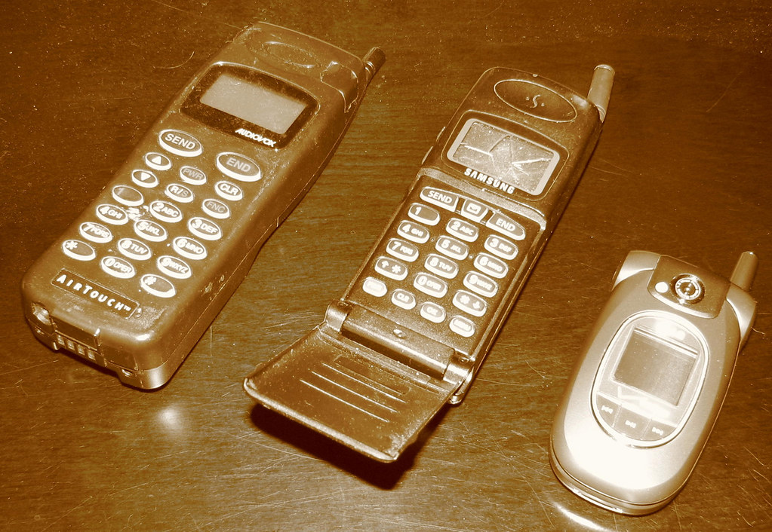
THANK YOU!
This Photo by Unknown Author is licensed under CC BY-NC-ND

